Slide 1
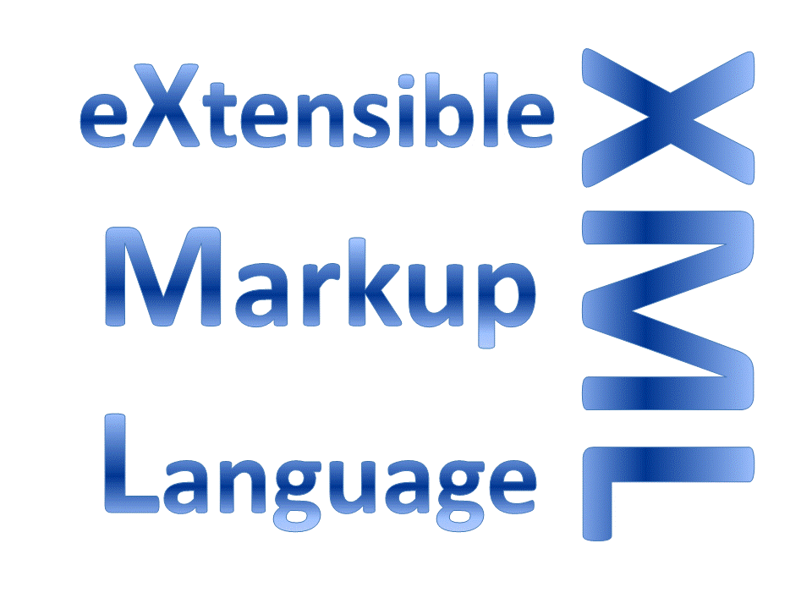

AN OVERVIEW OF XML WITH ADVANTAGES AND DISADVANTAGES OF XML
Navachethan.M
1NT18IS099

Slide 2

OverView of XML:
Introduction:
XML stands for eXtensible Markup Language.
XML is basically used to describe the data.
XML was designed to store and transport data.
XML was designed to be both human- and machine-readable.

Slide 3
XML Syntax and Rules:
XML must have a root element initially which is determined as
parent element.
Example:
<root> <child> <subchild>.....</subchild> </child> </root>
XML declaration: <?xml version="1.0" encoding="UTF-8"?>
XML elements should have a closing tag. <p>This is a paragraph.</p>
XML tags are case sensitive. <p>some text</p> {right syntax}
<p>some text </P> {wrong syntax}
XML elements must be properly nested
Example: <b><i>This text is bold and italic</i></b>

Slide 4
XML Elements, Attributes and namespaces
An XML element includes opening tag and ending tag along with the data and the attributes:
Example:
<tag attribute=“-”>some text</tag>
XML elements can have attributes, just like HTML.
Attributes are designed to contain data related to a specific element.
The attributes defined should be in double or single quotes.
Example:
<person gender="female">
XML Namespaces provide a method
to avoid element name conflicts.
Example:
<h:table> <h:tr> <h:td>Apples</h:td> <h:td>Bananas</h:td> </h:tr> </h:table> <f:table> <f:name>African Coffee Table</f:name> <f:width>80</f:width> <f:length>120</f:length> </f:table>

Slide 5
XML Validator ?
XML Validator is a method of testing the the XML document to check the errors.
An XML document with correct syntax is called "Well Formed".
XML documents must have a root element
XML elements must have a closing tag
XML tags are case sensitive
XML elements must be properly nested
XML attribute values must be quoted.
A "well formed" XML document is not the same as a "valid" XML document.
A "valid" XML document must be well formed without any errors. In addition, it must conform to a document type definition.
There are two different document type definitions that can be used with XML:
1. DTD - Document Type Definition
2. XML Schema - An XML-based alternative to DTD
A document type definition defines the rules and the legal elements and attributes for an XML document.

Slide 6
XML DTD- Document Type Definition
DTD stands for Document Type Definition.
A DTD defines the structure and the legal elements with attributes of an XML
Example:
#PCDATA means parsable character data document.
<?xml version="1.0" encoding="UTF-8"?> <!DOCTYPE note SYSTEM "Note.dtd"> <note> <to>Tove</to> <from>Jani</from> <heading>Reminder</heading> <body>Don't forget me this weekend!</body> </note>
Note.dtd:
<!DOCTYPE note [ <!ELEMENT note (to,from,heading,body)> <!ELEMENT to (#PCDATA)> <!ELEMENT from (#PCDATA)> <!ELEMENT heading (#PCDATA)> <!ELEMENT body (#PCDATA)> ]>

Slide 7
XML Schema
An XML Schema describes the structure of an XML document, just like a DTD
Example:
<?xml version="1.0" encoding="UTF-8"?> <!DOCTYPE note SYSTEM "Note.dtd"> <note> <to>Tove</to> <from>Jani</from> <heading>Reminder</heading> <body>Don't forget me this weekend!</body> </note>
<xs:element name="note"> <xs:complexType> <xs:sequence> <xs:element name="to" type="xs:string"/> <xs:element name="from" type="xs:string"/> <xs:element name="heading" type="xs:string"/> <xs:element name="body" type="xs:string"/> </xs:sequence> </xs:complexType> </xs:element>

Slide 8

Advantages:
1. XML is platform independent and programming language independent, thus it can be used on any system and supports the technology change when that happens.
2. XML supports unicode. Unicode is an international encoding standard for use with different languages and scripts, by which each letter, digit, or symbol is assigned a unique numeric value that applies across different platforms and programs. This feature allows XML to transmit any information written in any human language.
3. The data stored and transported using XML can be changed at any point of time without affecting the data presentation. Generally other markup language such as HTML is used for data presentation, HTML gets the data from XML and display it on the GUI (graphical user interface), once data is updated in XML, it does reflect in HTML without making any change in HTML GUI.

Slide 9
Advantages
4. XML allows validation using DTD and Schema. This validation ensures that the XML document is free from any syntax error.
5. XML simplifies data sharing between various systems because of its platform independent nature. XML data doesn’t require any conversion when transferred between different systems.
6. The hierarchical structure is suitable for most (but not all) types of documents.
7. It is based on international standards and Its self-documenting format describes structure , field names as well as specific values.
8. XML can store binary information. The binary data must be converted to text with the help of "Base64".

Slide 10

Disadvantages
1. XML syntax is verbose and redundant compared to other text-based data transmission formats such as JSON.
2. The redundancy in syntax of XML causes higher storage which reflects on the performance of the program and transportation cost when the volume of data is large.
3. XML document is less readable compared to other text-based data transmission formats such as JSON.

Slide 11

Disadvantages
4. XML doesn’t support array.
5. XML file sizes are usually very large due to its verbose nature, it is totally dependant on who is writing it.
6. XML namespaces are problematic to use and namespace support can be difficult to correctly implement in an XML parser.
7. The distinction between content and attributes in XML seems unnatural to some and makes designing XML data harder.
8. XML requires separate XML stylesheet to use it for more than basic display of data.

Slide 12
How to overcome Disadvantage?
The major problems arise from the xml are:
Consumes more storage due to large file size.
Difficult to read due to its verbose nature.
Doesn’t support array
Occurrence of Errors due to strict syntax rules and XML namespaces makes it difficult to distinguish the data.
So to overcome the above Disadvantages a new method is followed that has simplified syntax ,consumes less space and supports array. It’s called as JSON (JavaScript Object Notation).
Let’s get the basic knowledge of JSON.

Slide 13
JSON: Introduction and History:
JavaScript Object Notation is an open standard file format, and data interchange format, that uses human-readable text to store and transmit data objects consisting of attribute–value pairs and array data types. It is a very common data format, with a diverse range of applications, such as serving as a replacement for XML in AJAX systems.
Douglas Crockford first specified and popularized the JSON format in 2001.

Slide 14
Data types & Syntax:
JSON allows the following data types:
Number
String
Boolean
Array
Object
Null

Slide 15
Example:
{
"firstName": "John",
"lastName": "Smith",
"isAlive": true,
"age": 27,
"address": {
"streetAddress": "21 2nd Street",
"city": "New York",
"state": "NY",
"postalCode": "10021-3100"
},
"phoneNumbers": [
{
"type": "home",
"number": "212 555-1234"
},
{
"type": "office",
"number": "646 555-4567"
}
],
"children": [],
"spouse": null
}

Slide 16
Summary:
From this presentation we have a brief knowledge about an overview of XML , rules and syntax.
We have basic knowledge on validation of XML files.
We have also covered the main objective of understanding the advantages and Disadvantages of XML format.
We have also gathered a small information about another method of describing data which is more efficient than XML i.e. JSON.

Slide 17
Summary:
Advantages of XML | Disadvantages of XML
XML is platform independent | XML syntax is verbose and redundant compared to other text-based data transmission formats such as JSON.
XML supports unicode | The redundancy in syntax of XML causes higher storage which reflects on the performance of the program
The data stored and transported using XML can be changed at any point of time without affecting the data presentation | XML document is less readable compared to other text-based data transmission formats such as JSON.
XML allows validation using DTD and Schema | XML doesn’t support array
The hierarchical structure is suitable for most (but not all) types of documents. | XML namespaces are problematic to use
XML can store binary information. The binary data must be converted to text with the help of "Base64". | XML requires separate XML stylesheet to use it for more than basic display of data.

Slide 18

Reference:
W3schools.com
Wikipedia.org
BeginnersBook.com
HTML5 Black Book

Slide 19
Thank you

